Slide 1
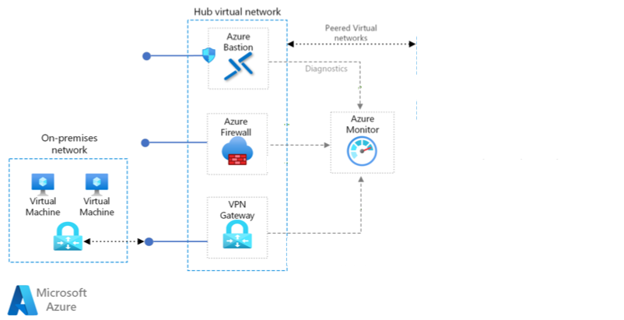



Preferred Solution Diagram
Hub Virtual Network
Spoke Virtual Network
Subnet: Front-end
On-Premises Network
Azure Arc-enabled
Virtual Machines
Subnet: REST API Back-end
Subnet: Azure SQL MI
Azure ExpressRoute

